Slide 1
Basic Web Application
By: Somesh Rao Coka
ST122892

Slide 2
AGENDA
Introduction​
Services used
Objective
System Architecture
​Well Architecture Framework
​Summary​

Slide 3
Introduction

Slide 4
I will first build a static web app that renders "Hello World."
Then I will add functionality to the web app so the text that displays is based on a custom input you provide.
I will be :
Creating a web app
Connecting the web app to a serverless backend
Add interactivity to your web app with an API and a database

Slide 5
Services used
AWS Amplify
AWS IAM
AWS API Gateway
AWS Lambda
AWS DynamoDB

Slide 6
Objectives

Slide 7
Create Web App : Deploy static resources for your web application using the AWS Amplify Console.
Build Serverless Function: Build a serverless function using AWS Lambda.
Link Serverless Function to Web App : Deploy your serverless function with API Gateway.
Create Data Table: Persist data in an Amazon DynamoDB table.
Add Interactivity to Web App : Modify your web app to invoke your API.

Slide 8
Create Web App
I will be using the AWS Amplify console to deploy the static resources for my web application.
Amplify can host any static web content - including HTML, CSS, JavaScript, images, and other files - will be hosted by AWS Amplify.
Notes:
why apmplify
I selected the Amplify service because it makes it straightforward to host and deploy static websites. In end users will access your site using the URL exposed by Amplify..
For most real applications we will be using a custom domain to host our site. A "custom domain" is a unique branded name that identifies a website, such as www.amazon.com. If you're interested in this, Amplify provides support for custom domains as well.

Slide 9
Key takeaways
Static website – A static website has fixed content, unlike dynamic websites. Static websites are the most basic type of website and are the easiest to create. All that is required is creating a few HTML pages and publishing them to a web server.
Web hosting – Provides the technologies/services needed for the website to be viewed on the internet.
AWS Regions – Separate geographic areas that AWS uses to house its infrastructure. These are distributed around the world so that customers can choose a Region closest to them to host their cloud infrastructure there.

Slide 10
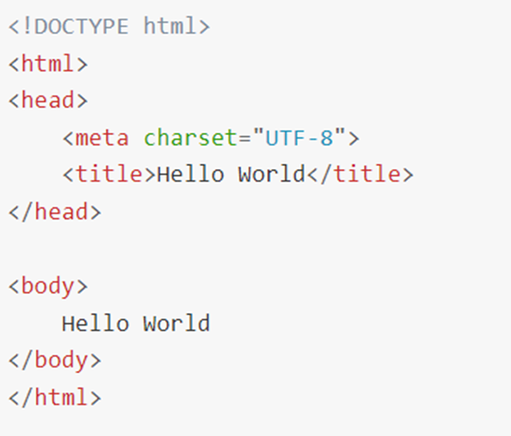

Slide 11
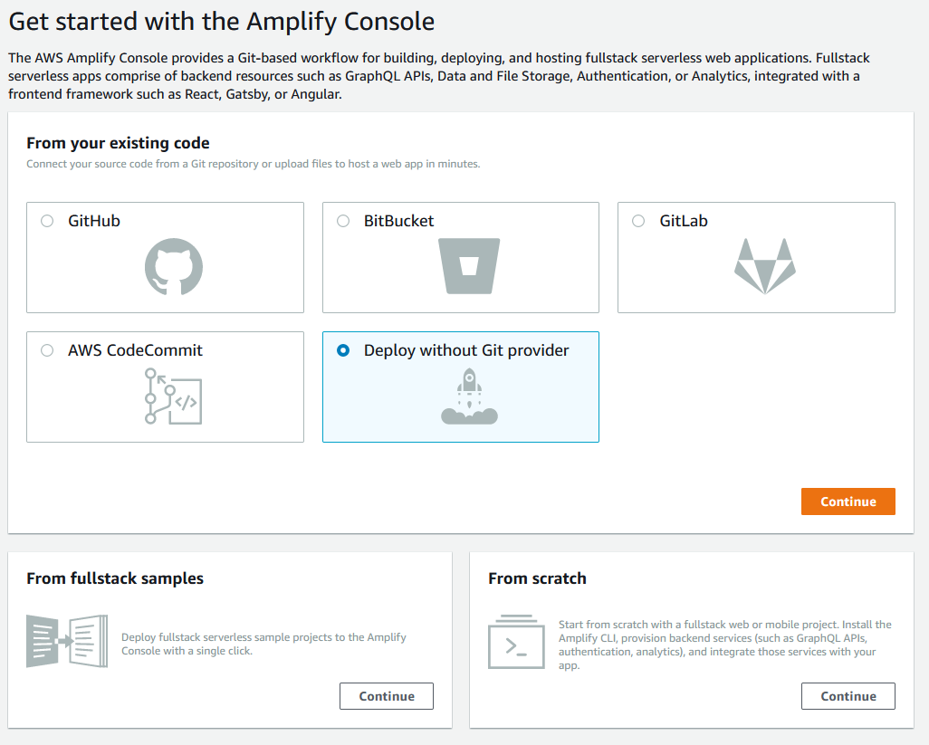

Slide 12
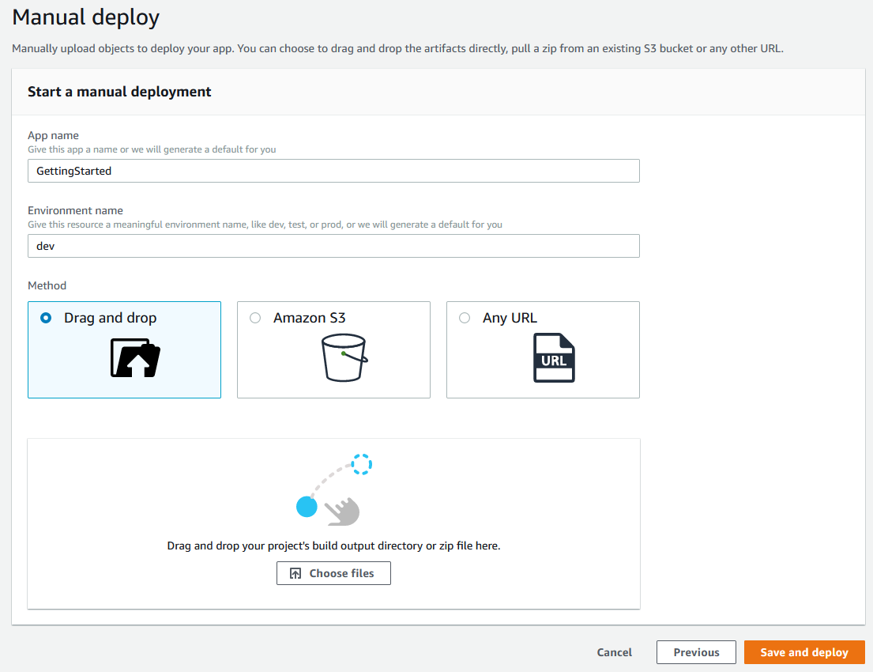

Slide 13
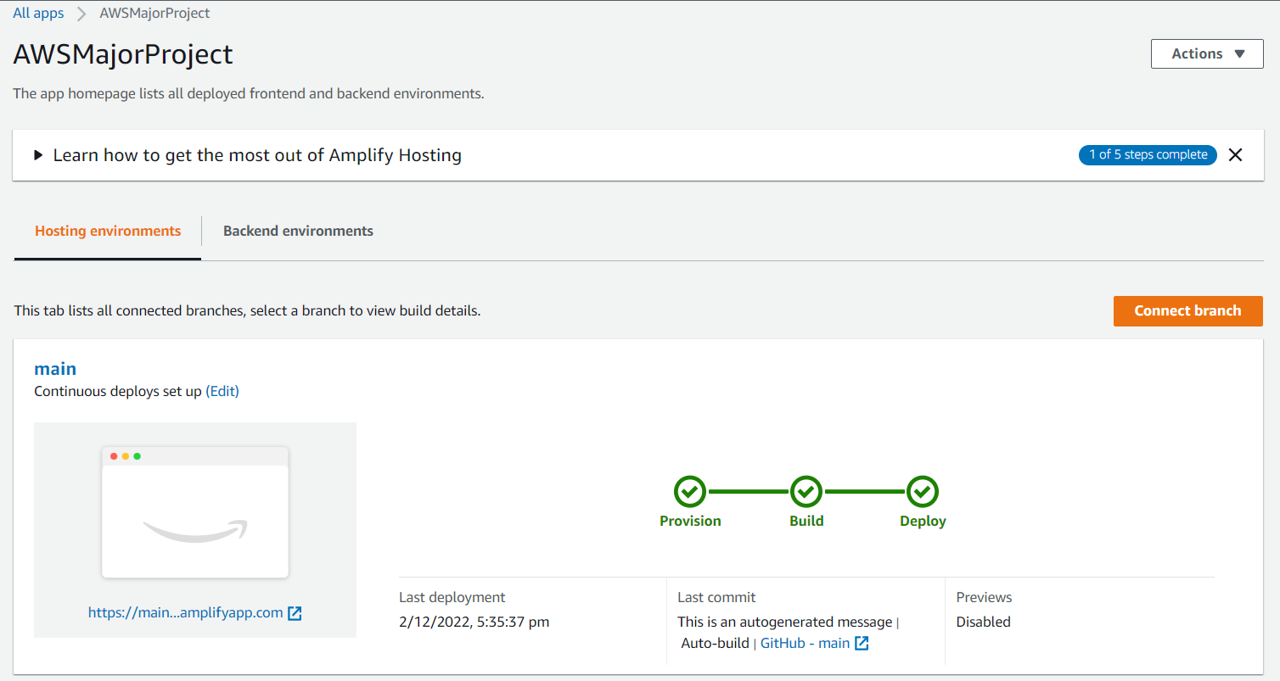

Slide 14
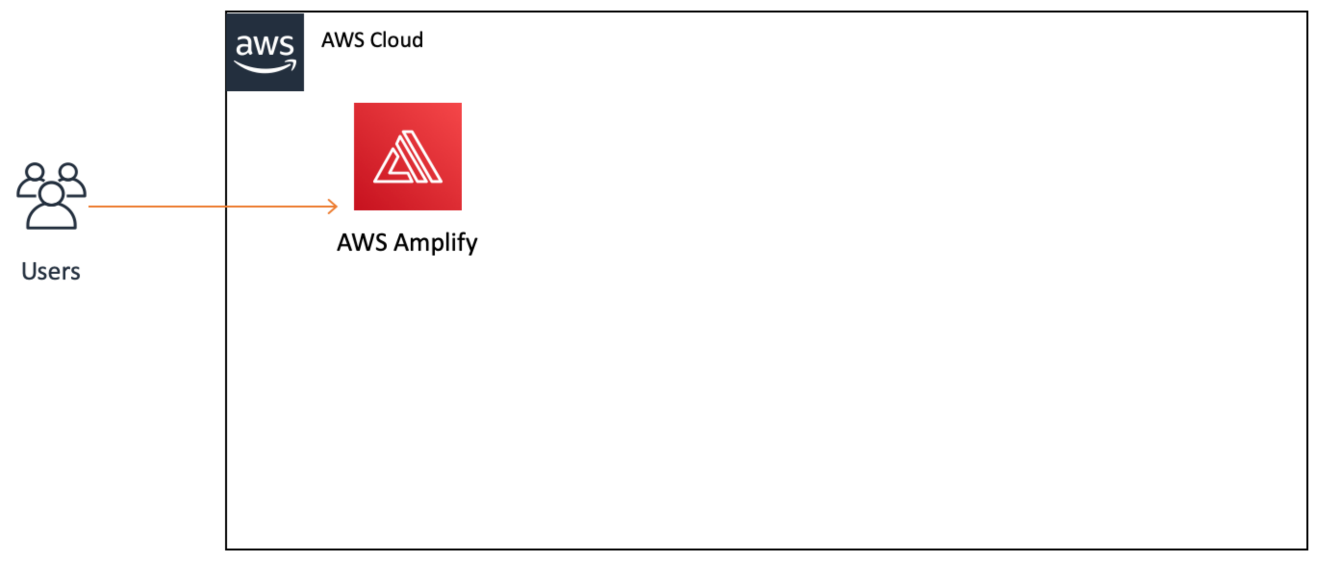
Where we are now?
Notes:
It is pretty minimal right now because we are only using the AWS Amplify console. We now have a live web app users can interact with. Next, we will create a Lambda function.

Slide 15
Build a Serverless Function
I will be using AWS Lambda here & I will be writing a small piece of code, in Python, JavaScript, or Java.
It offers us a large variety of programming languages to write code.
I will be :
Creating a Lambda function from scratch using the AWS console (in Python, JavaScript, or Java)
Creating (JSON) events in the AWS console to test our function
Notes:
AWS Lambda is a serverless compute service that runs your code in response to events and automatically manages the underlying compute resources for you. These events may include changes in state or an update, such as a user placing an item in a shopping cart on an e-commerce website.

Slide 16
Key Takeaways
Compute service – A service that provides computational processing power.
Serverless function – A piece of code that will be executed by a compute service, on demand.
Lambda trigger – The type of event that will make a Lambda (serverless) function run. This can be another AWS service or external input.
Notes:
Three components comprise AWS Lambda:
A function. This is the actual code that performs the task.
A configuration. This specifies how your function is executed.
An event source (optional). This is the event that triggers the function. You can trigger with several AWS services or a third-party service.

Slide 17
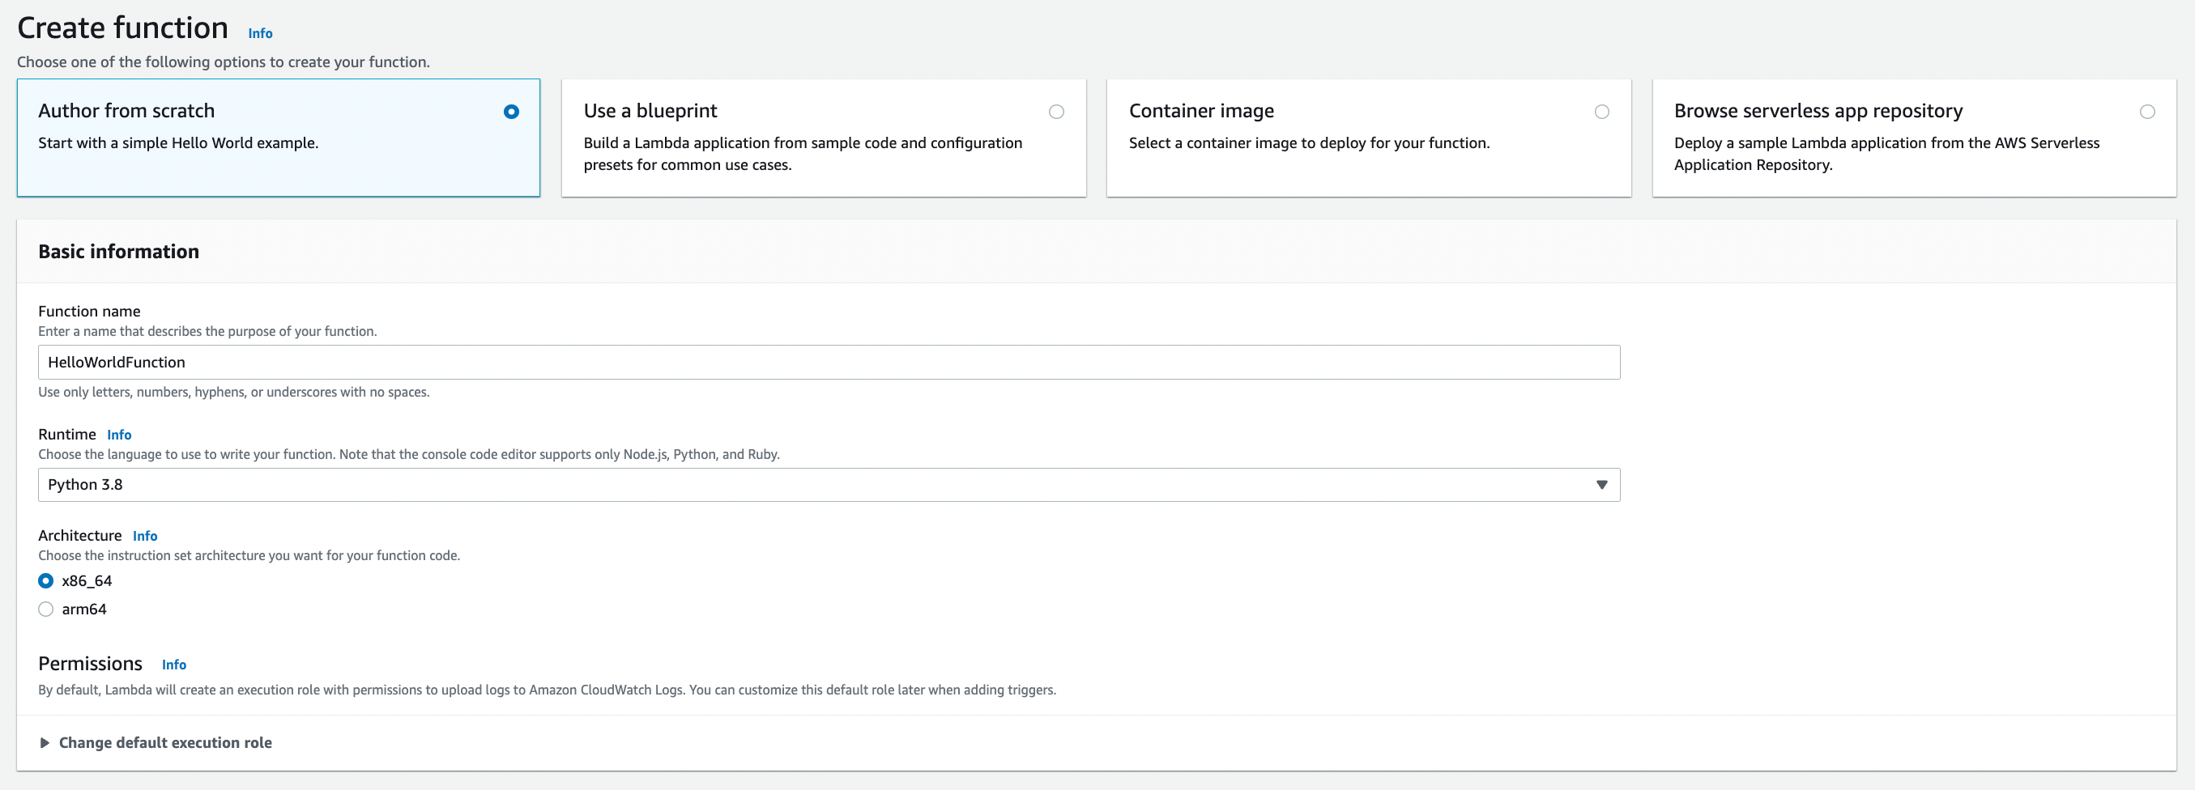

Slide 18
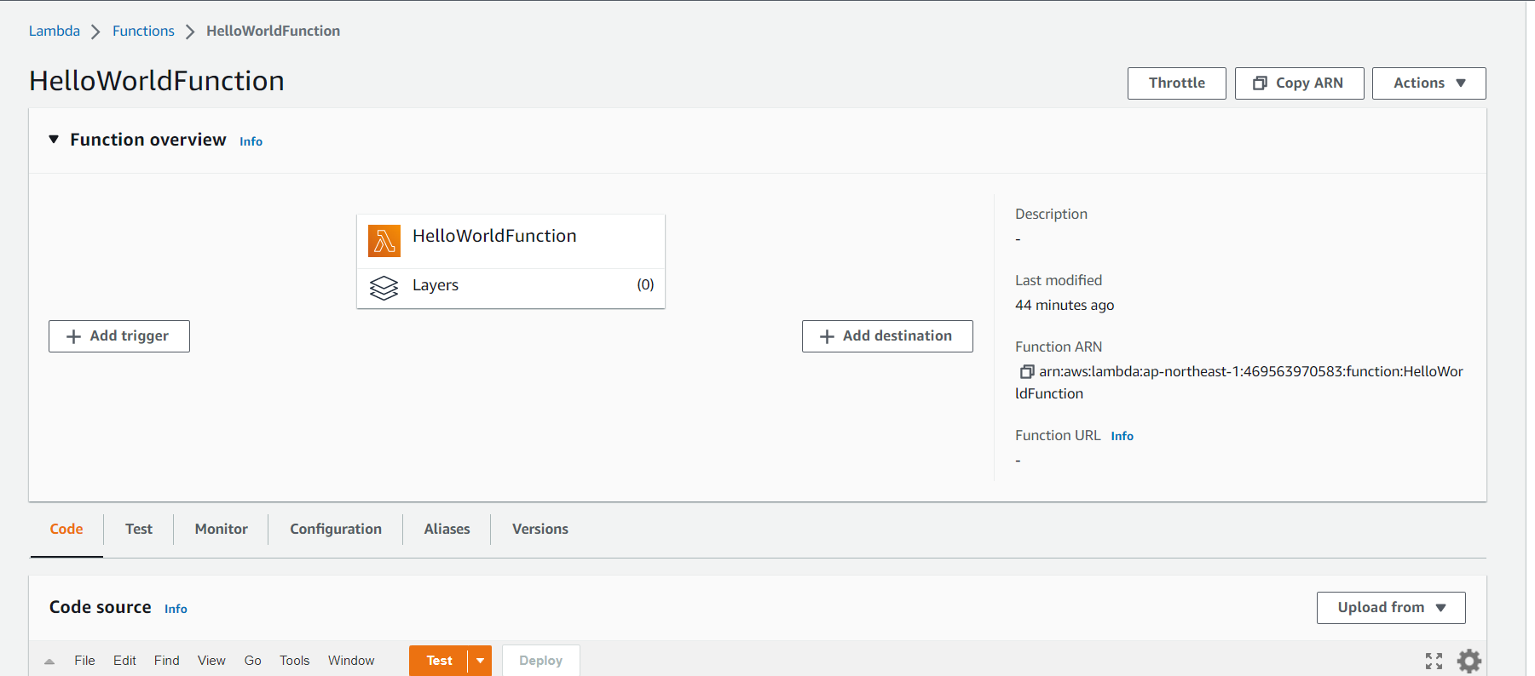

Slide 19
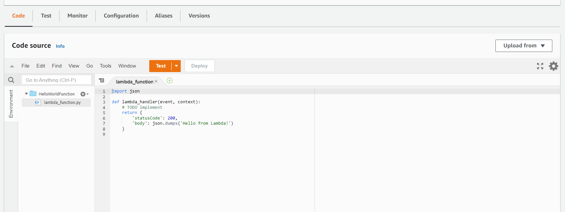

Slide 20
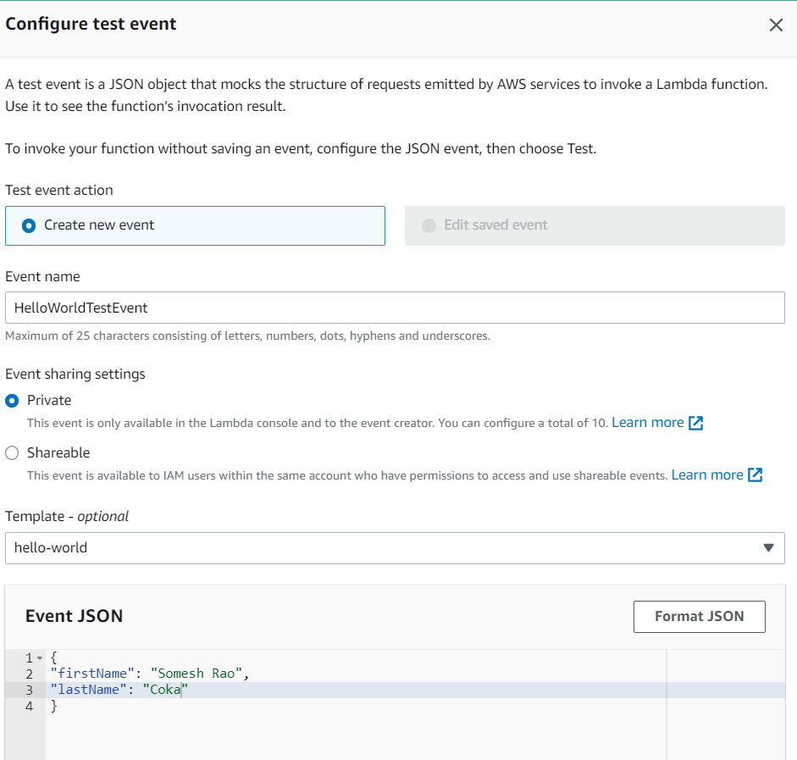

Slide 21
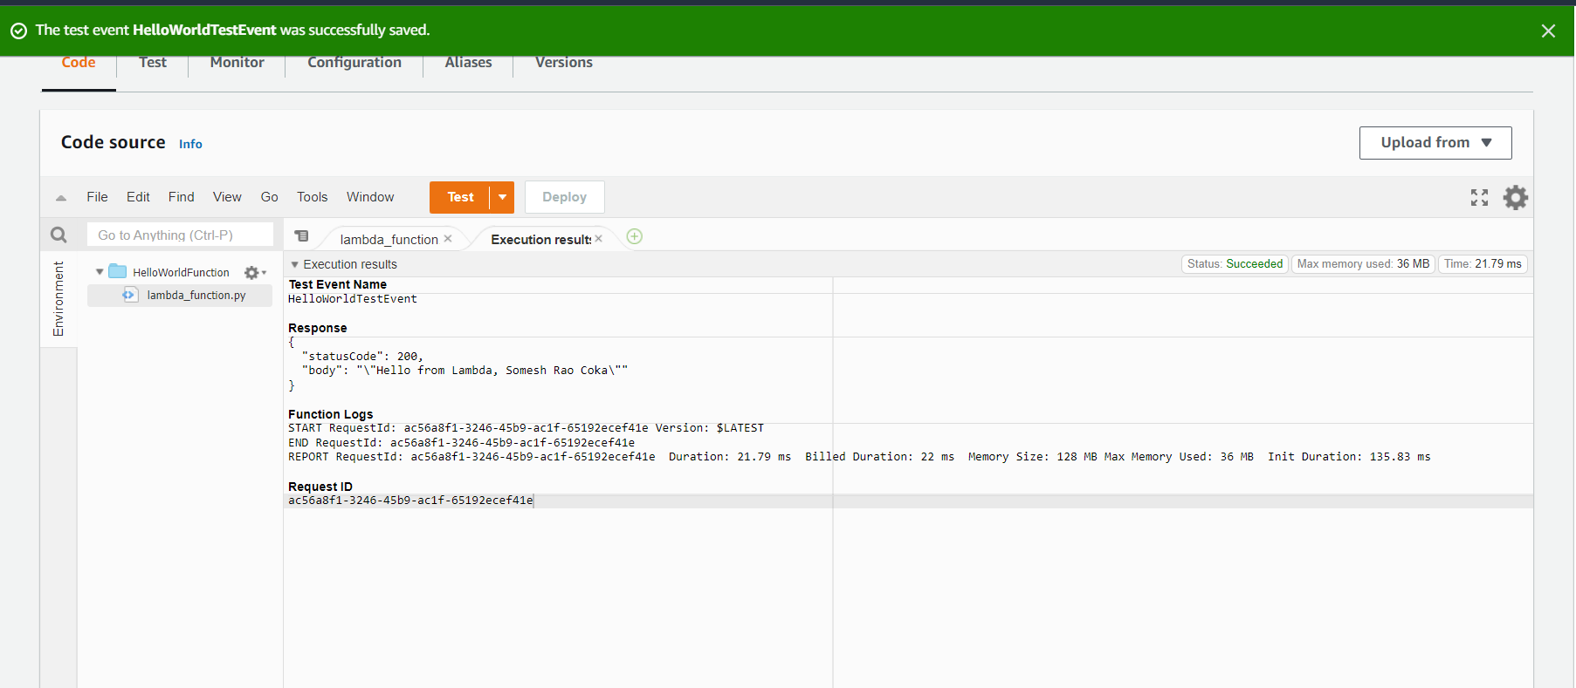
Notes:
Upon clicking test we get to see these results

Slide 22
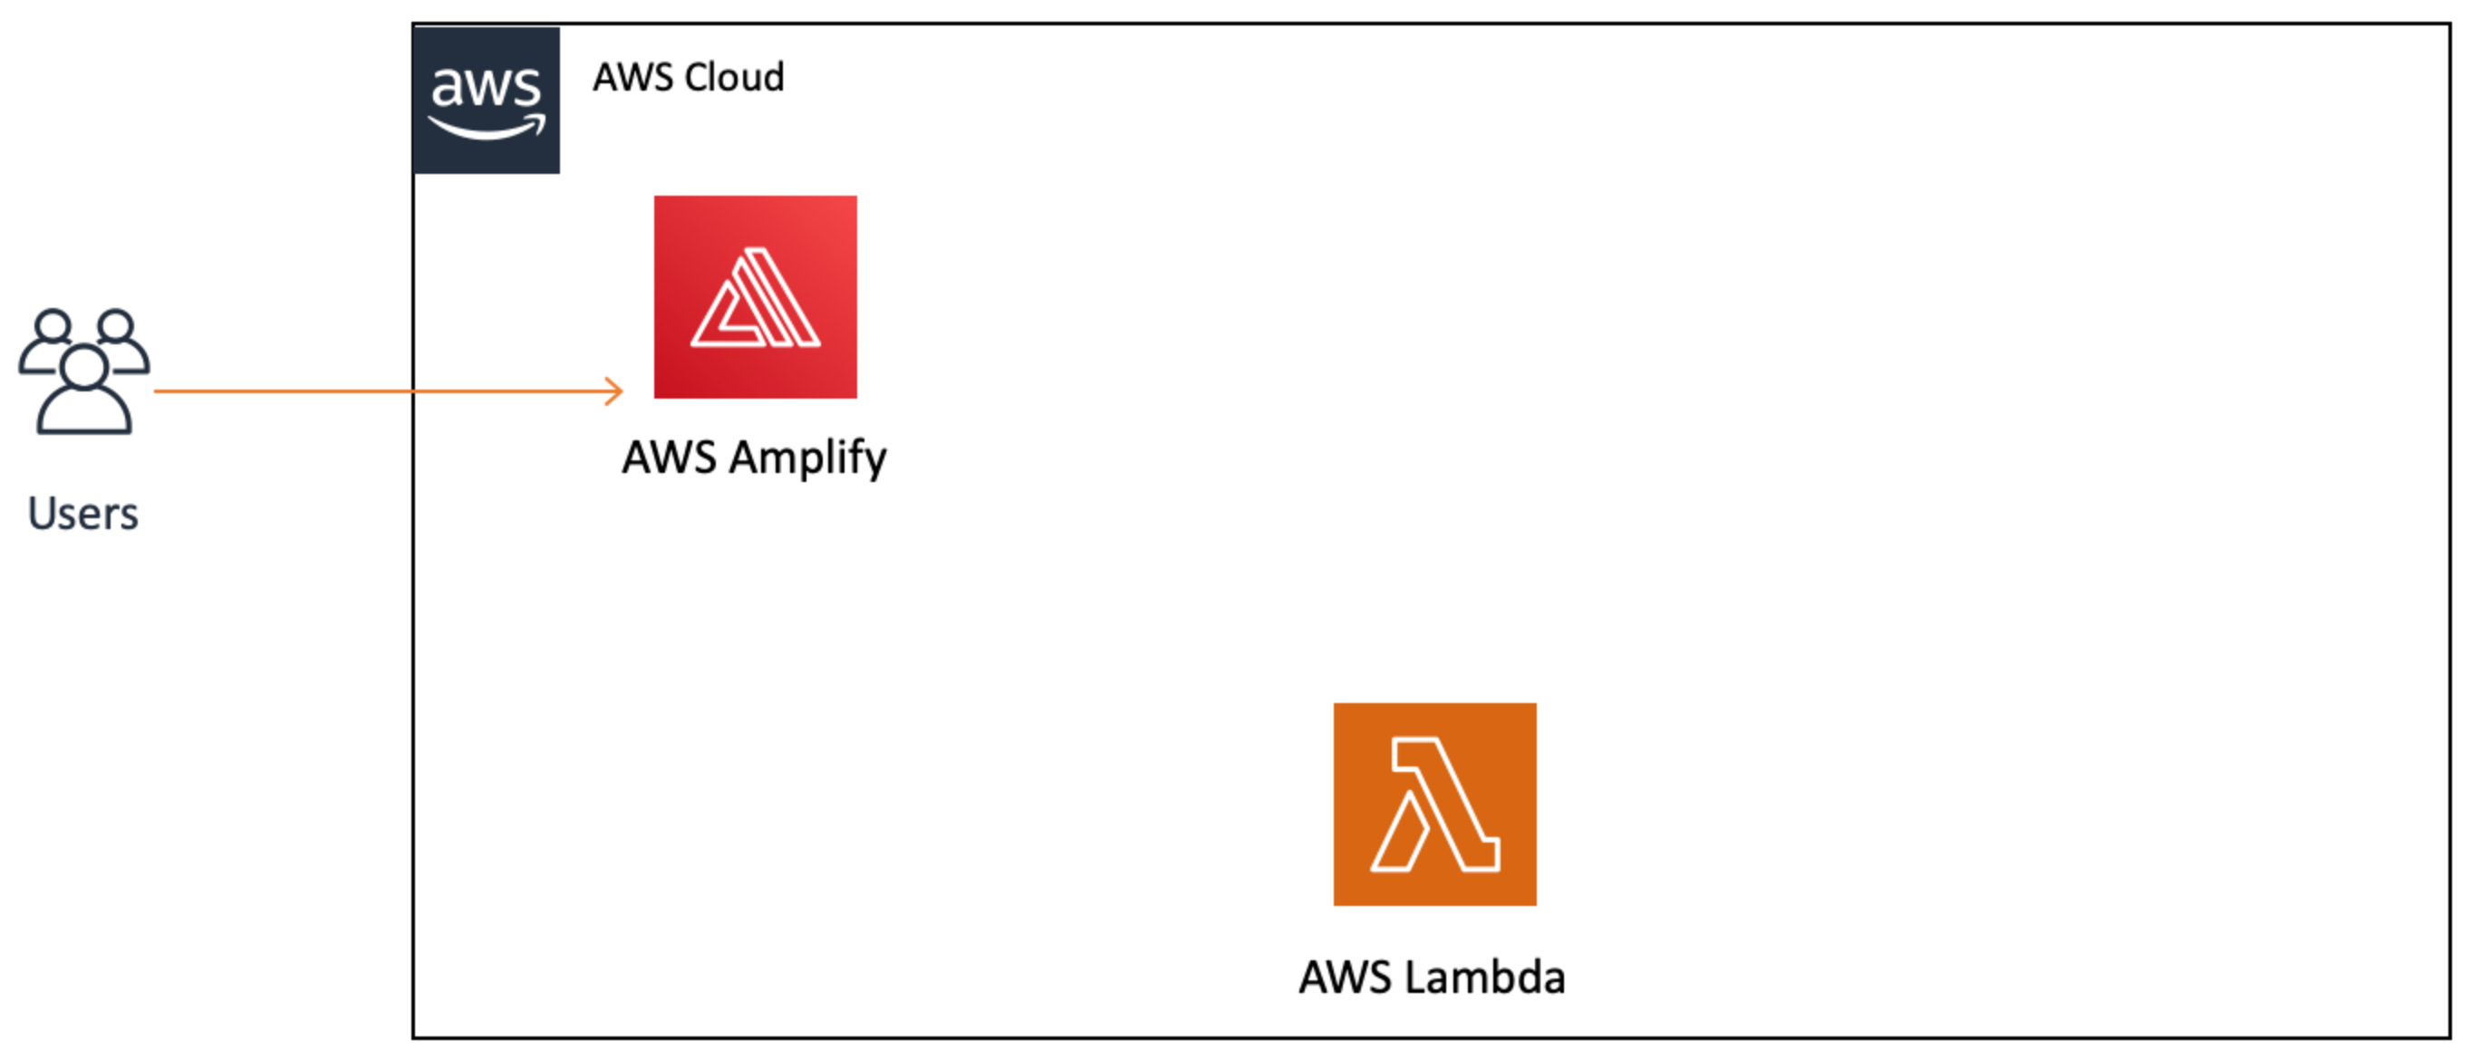
Where we are now?
Notes:
You will notice we added the AWS Lambda service to the diagram, but it does not yet have a connection to AWS Amplify or our users. We will build that out in the next module.

Slide 23
Link a Serverless Function to a Web App
we will use Amazon API Gateway to create a RESTful API that will allow us to make calls to our Lambda function from a web client (typically refers to a user's web browser).
API Gateway will act as a middle layer between the HTML client we created in module one and the serverless backend we created in module two.

Slide 24
I will :
Create a new API using API Gateway
Define HTTP methods on your API
Trigger a Lambda function from an API
Enable cross-origin resource sharing (CORS) on an API so you can consume resources from a different origin (domain)
Test an API created with API Gateway from the AWS Management Console

Slide 25
Key Takeaways
RESTful API — REST stands for "Representational State Transfer" and is an architectural pattern for creating web services. API stands for "application programming interface." Thus, a RESTful API is one that implements the REST architectural pattern.
HTTP request methods — HTTP methods are designed to enable communications between clients and servers. Methods, like GET or PUT defined by the HTTP protocol, are used to indicate what action to take on a resource.
CORS — The CORS browser security feature uses HTTP headers to tell a browser to allow a given web application running at one origin (domain) to access selected resources from a server at a different origin.
Edge optimized — A resource that uses AWS global infrastructure to better serve geographically diverse clients.

Slide 26
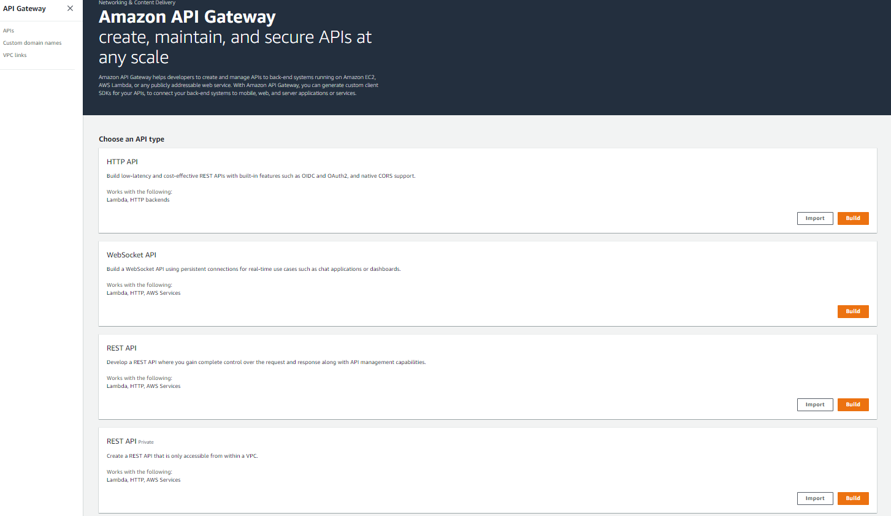

Slide 27
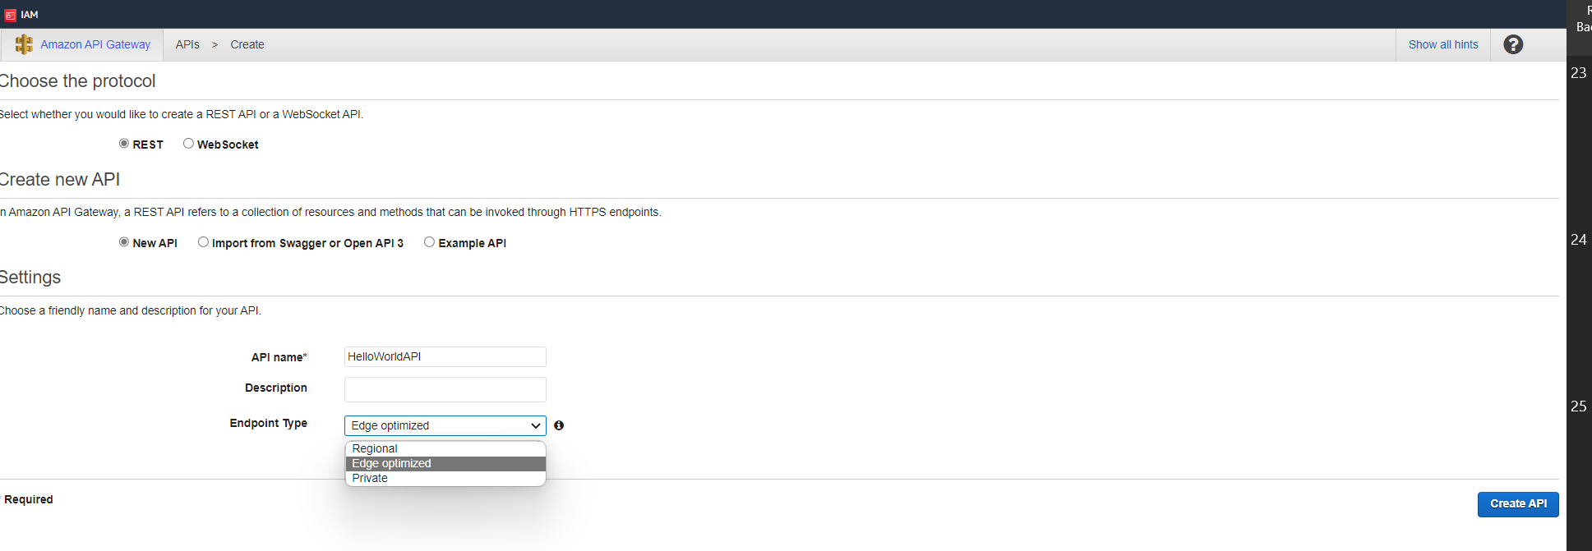

Slide 28
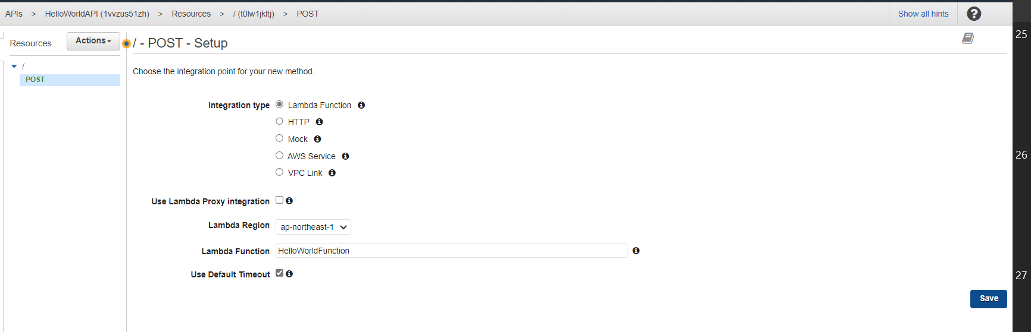

Slide 29
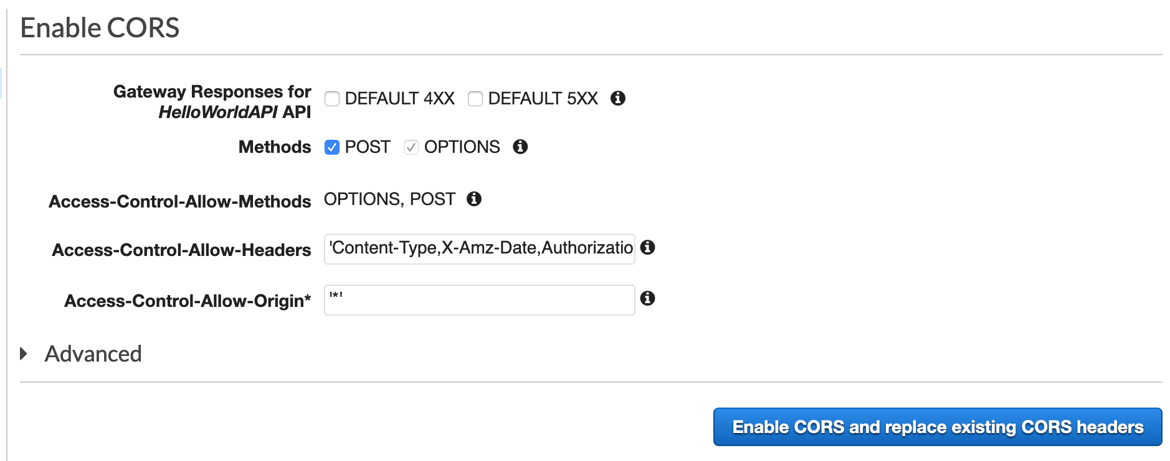
Notes:
Cross-origin resource sharing (CORS) is a browser security feature that restricts cross-origin HTTP requests that are initiated from scripts running in the browser. If your REST API's resources receive non-simple cross-origin HTTP requests, you need to enable CORS support

Slide 30
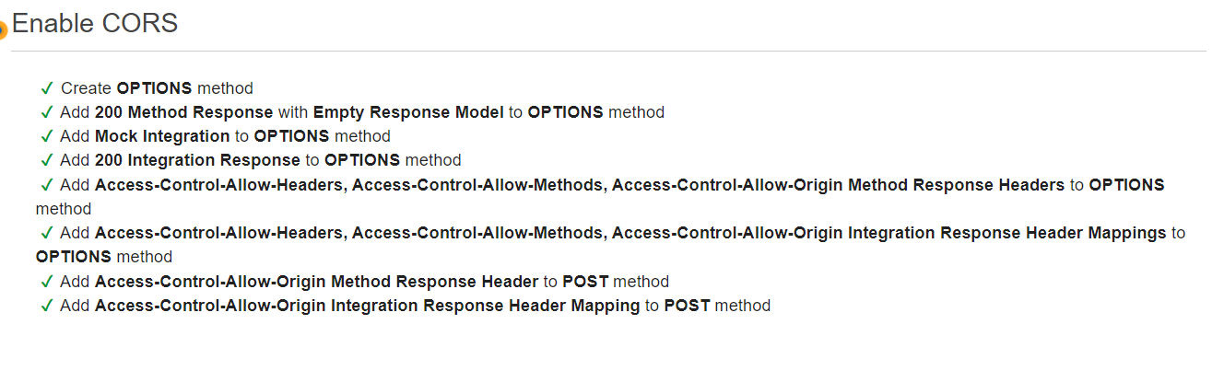

Slide 31
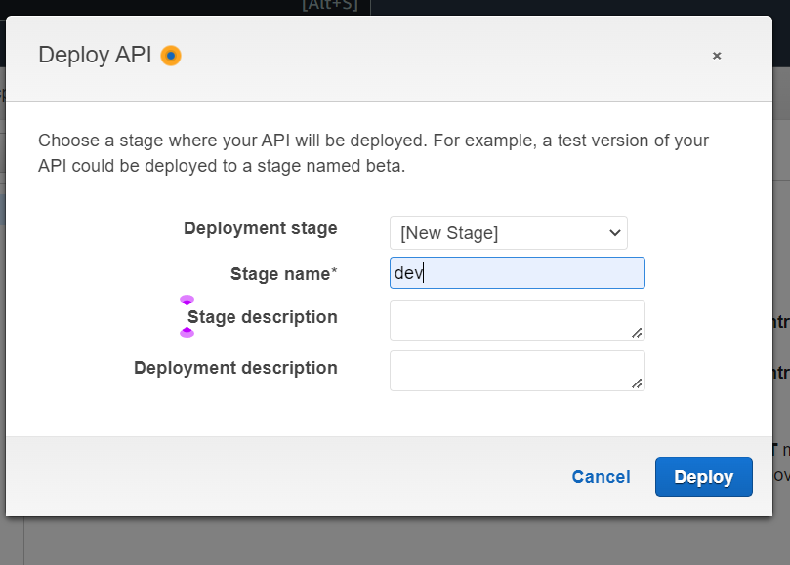

Slide 32
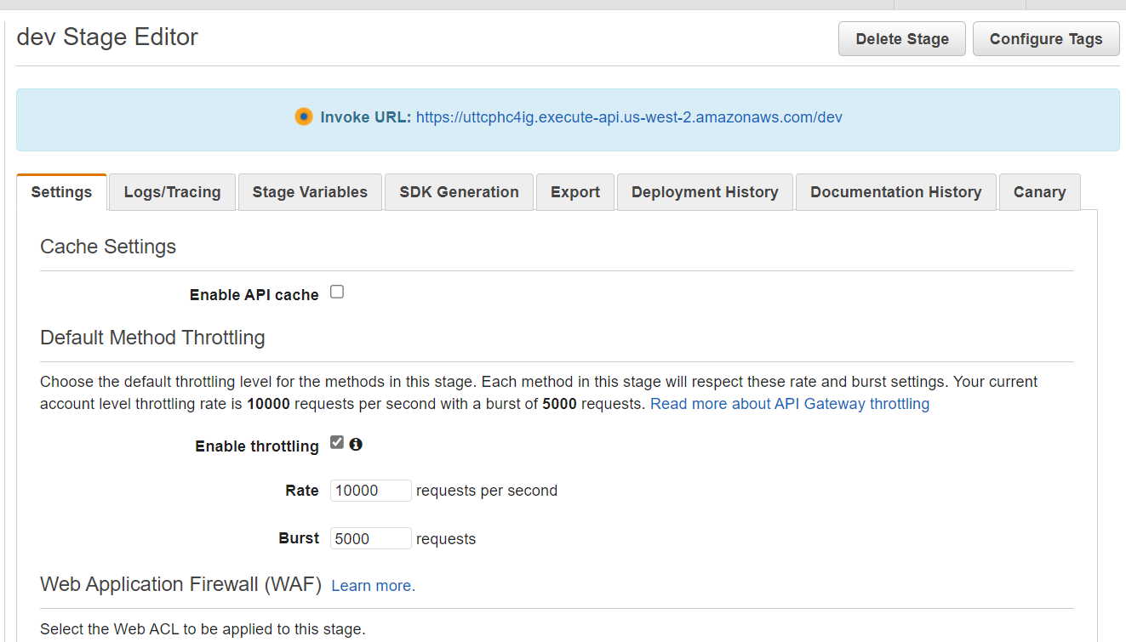

Slide 33
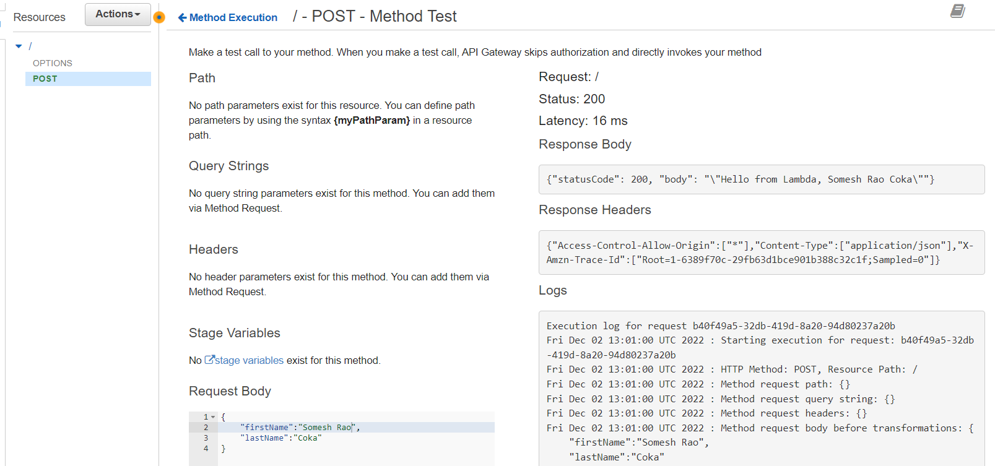
Notes:
We have built and tested an API that calls our Lambda function.

Slide 34
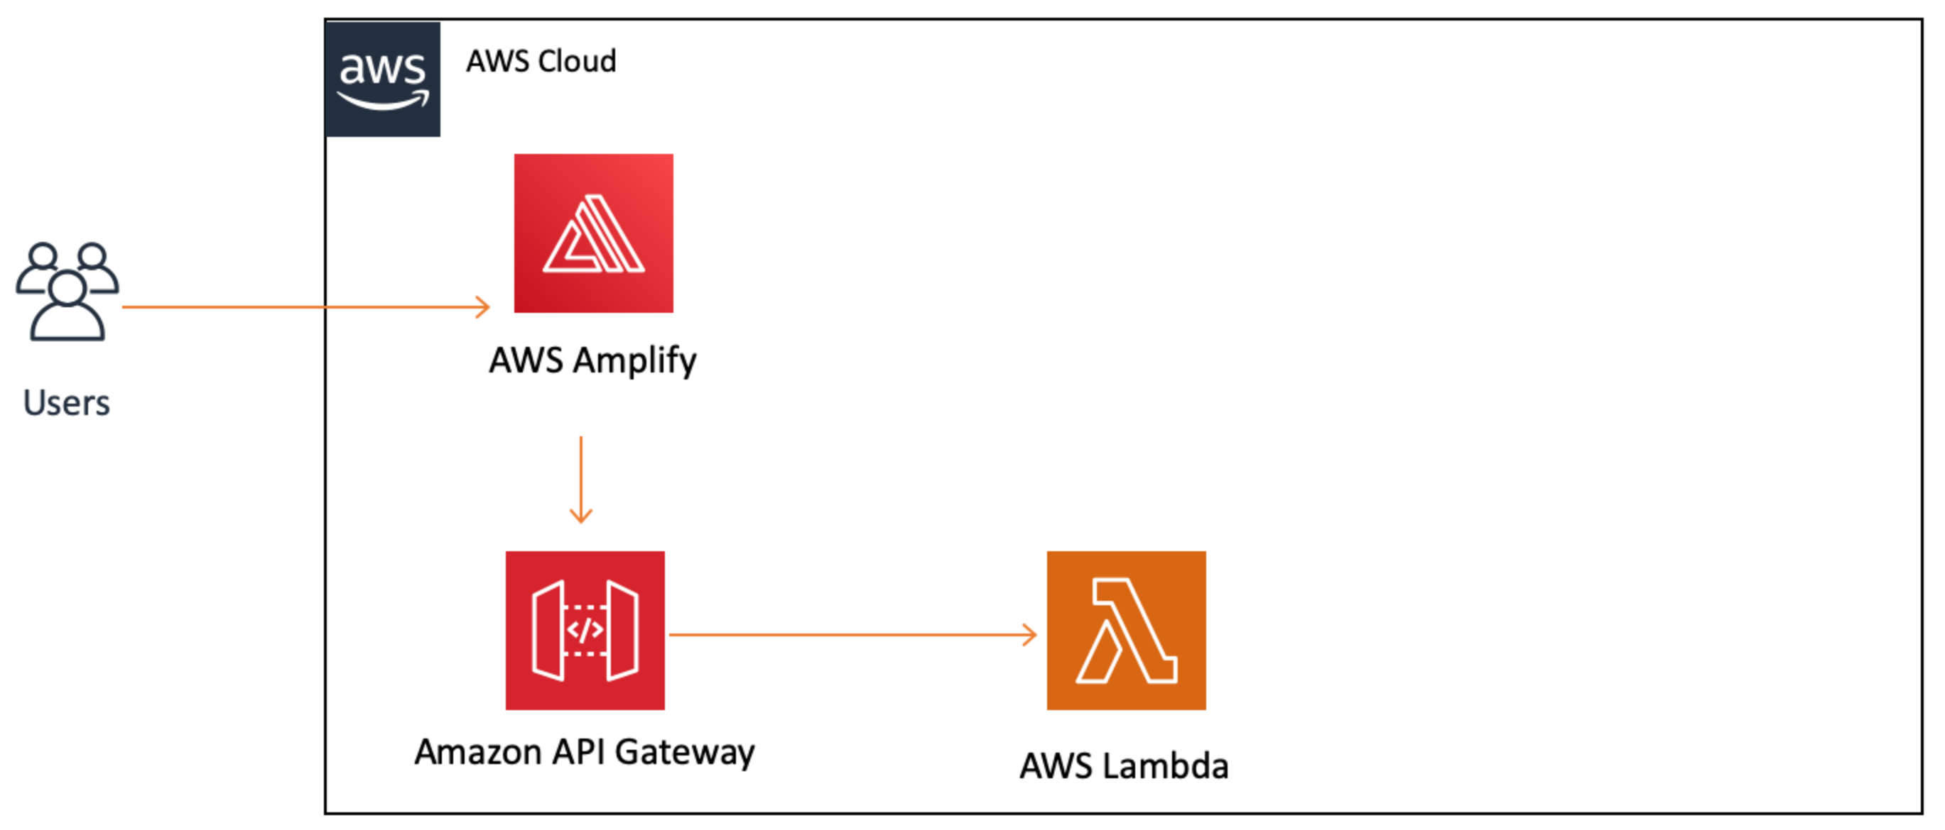
Where we are now?
Notes:
We added API Gateway and connected it to our existing Lambda function. Now, we can trigger our function with an API call. We are still missing the ability to generate this call from our web client. We will add our data table first in module four and connect everything together.

Slide 35
Create a Data Table
we will create a table to persist data using Amazon DynamoDB. DynamoDB is a key-value database service, so we do not need to create a schema for our data.
It has consistent performance at any scale and there are no servers to manage when using it.

Slide 36
Additionally, we will use the AWS Identity and Access Management (IAM) service to securely give our services the required permissions to interact with each other.
Specifically, we are going to allow the Lambda function we created previously to write to our newly created DynamoDB table using an IAM policy.
To do this, we will use the AWS SDK (Python, JavaScript, or Java) from our Lambda function.

Slide 37
I will :
Create a DynamoDB table using the AWS Management Console
Create a role and manage permissions with IAM
Write to a DynamoDB table using the AWS SDK (Python, JavaScript, or Java)

Slide 38
Key Takeaways
Persisting data — Storing data so we can access it in the future, independently from program execution.
Non-relational database — Non-relational databases do not use a tabular schema of rows and columns. Instead, they use a storage model that is optimized for the specific requirements of the type of data being stored.
Key-value database — A type of non-relational database that stores data as a collection of key-value pairs in which a key serves as a unique identifier.

Slide 39
Primary key — The value that will identify each piece of data in a DynamoDB table. This value will also serve to partition the table to make it scalable.
Schema — The organization of data that serves as a blueprint for how a database should be constructed.
AWS SDK — AWS SDKs (software development kits) provide a set of tools, libraries, documentation, code samples, processes, and guides that allow developers to create software applications on a specific platform.
IAM policy — A document that defines what AWS resources an entity, such as a service, user, or group, has access to.

Slide 40
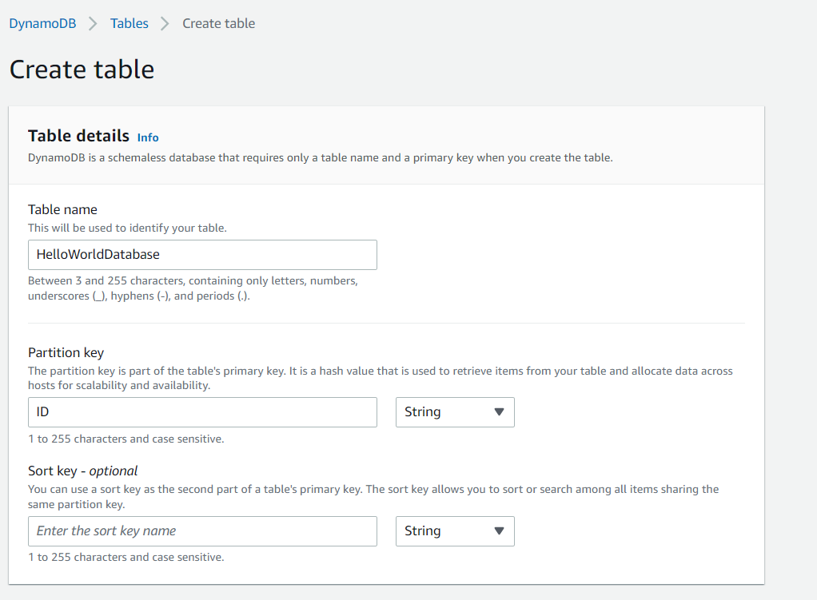

Slide 41
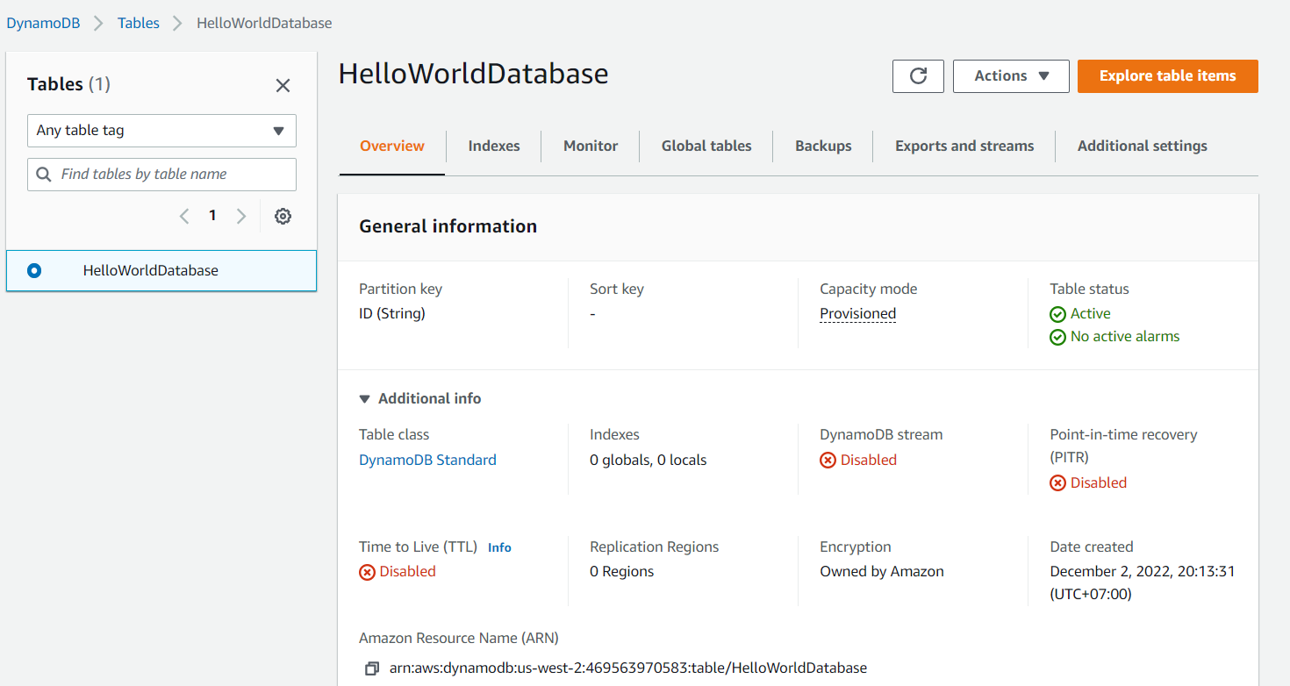

Slide 42
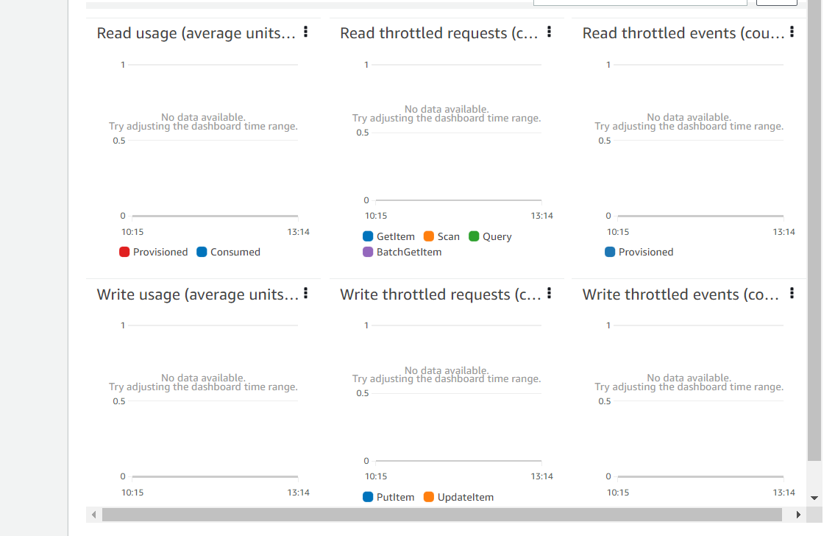
Notes:
All of these are empty well we will keep a eye at the end of the project

Slide 43
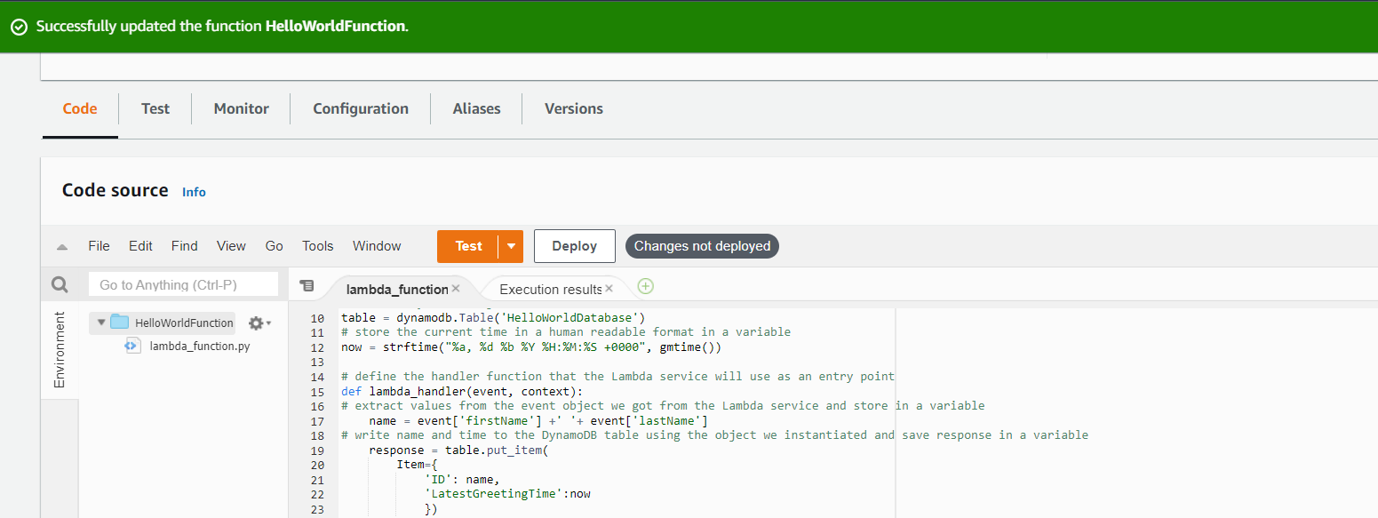

Slide 44
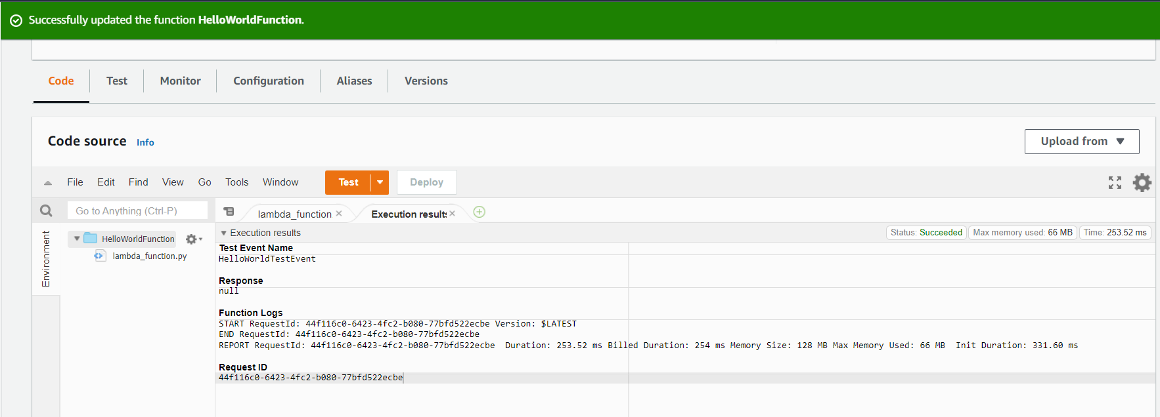

Slide 45
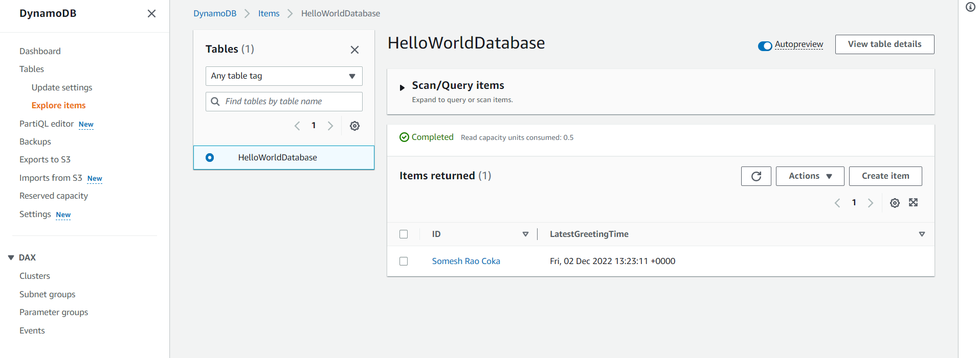
Notes:
Items matching your test event appear under Items returned. If you have been using our examples, the item ID will be Hello from Lambda, Somesh Rao.. Every time your Lambda function executes, your DynamoDB table will be updated. If the same name is used, only the time stamp will change.

Slide 46
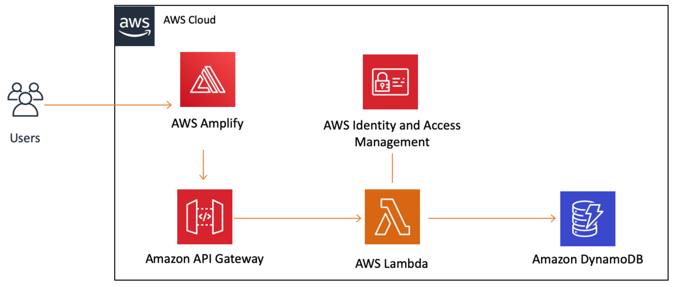
Where we are now?
Notes:
We added two services in this : DynamoDB (for storage) and IAM (for managing permissions securely). Both are connected to our Lambda function, so that it can write to our database. Now The final step is to add code to our client to call the API Gateway.

Slide 47
Add Interactivity to Your Web App
we will update the static website we created in module one to invoke the REST API we created in module three.
This will add the ability to display text based on what you input.
I will:
Call an API Gateway API from an HTML page
Upload a new version of a web app to the Amplify Console

Slide 48
Key takeaways
Deploying a website — Making a website available to users.
Environment — A stage such as "prod," "dev," or "staging," where an application or website can be executed.
Invoking an API — Sending an event to an API to trigger a specific behavior.

Slide 49
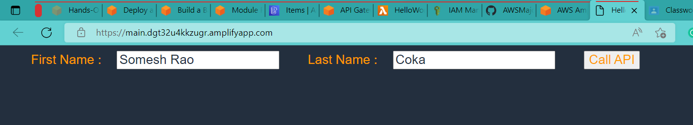
Notes:
We update our previous code
This ti,e we will use API Invoke URL from Api gateway console

Slide 50
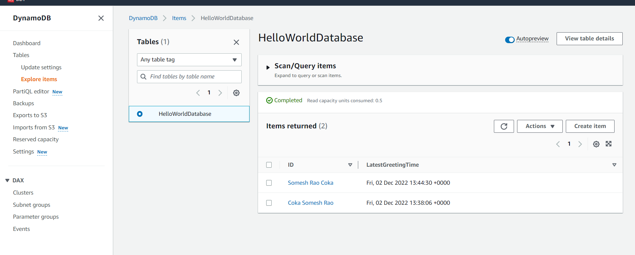

Slide 51
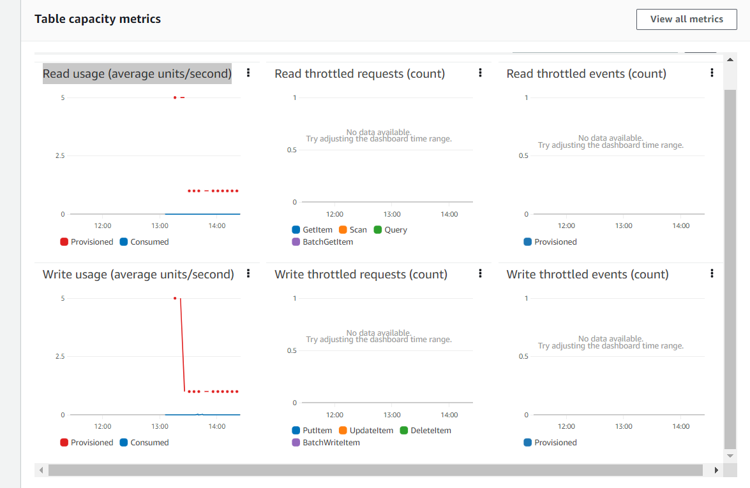

Slide 52

What we have done?
Notes:
All the AWS services we set up can securely communicate with each other. When a user chooses a button in the web app, it makes a call to our API, which triggers our Lambda function. Our Lambda function writes to a database and returns a message to our client via API Gateway. IAM manages all of the permissions.

Slide 53
Application architecture

Slide 55
Well Architecture Framework

Slide 56
Security Pillar: Yes, This implementation has IAM, and Detective controls with CloudWatch.
Operational Excellence: Yes, the implementation has AWS cloud watch providing Operation and Responses.
Reliability: This implementation has Foundations that include IAM and Lambda but it lacks Failure management.
Performance Efficiency: Yes, This project Gets aggregated views of the health and performance of all AWS resources using cloud watch.
Sustainability: Yes, this project includes a shared responsibility model for sustainability, and understanding the impact.

Slide 57
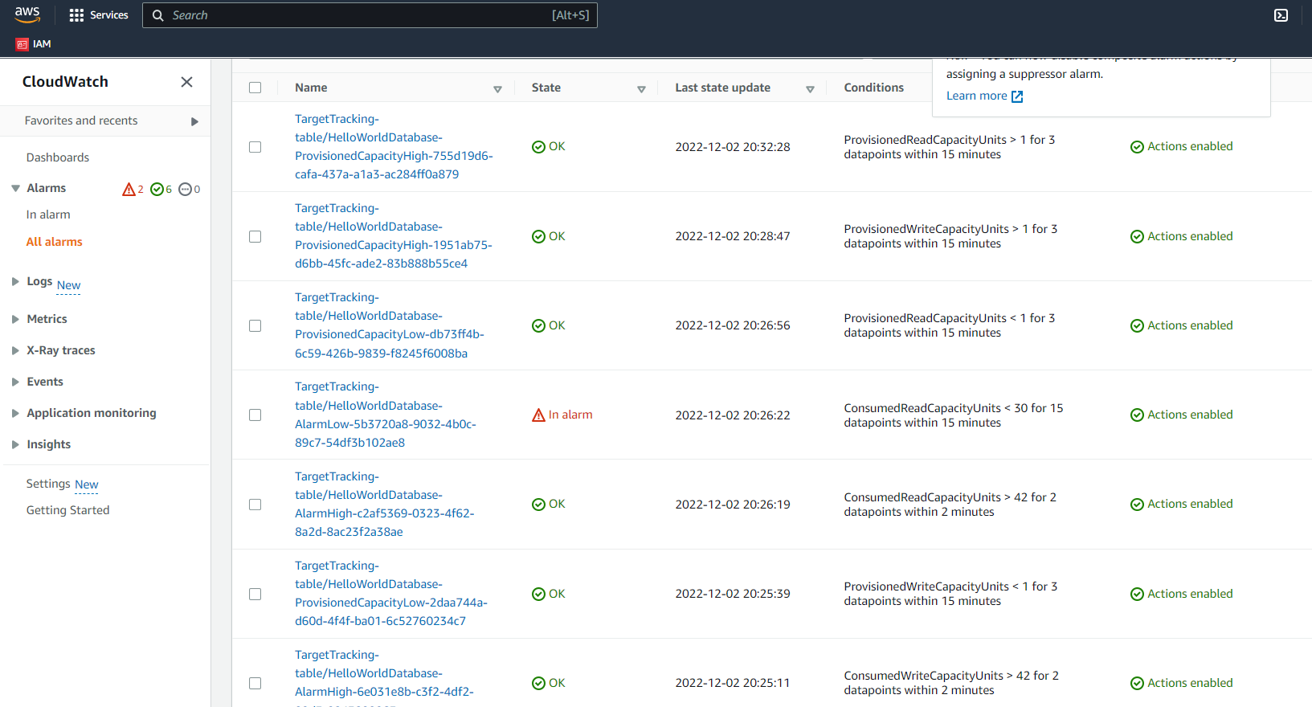

Slide 58
SUMMARY
All the AWS services we set up can securely communicate with each other. When a user chooses a button in the web app, it makes a call to our API, which triggers our Lambda function. Our Lambda function writes to a database and returns a message to our client via API Gateway. IAM manages all of the permissions.

Slide 59
THANK YOU
Somesh Rao Coka
ST122892
cokasomeshrao@outlook.com

